Slide 1
健康 vs. 不健康
健康
不健康

Slide 2
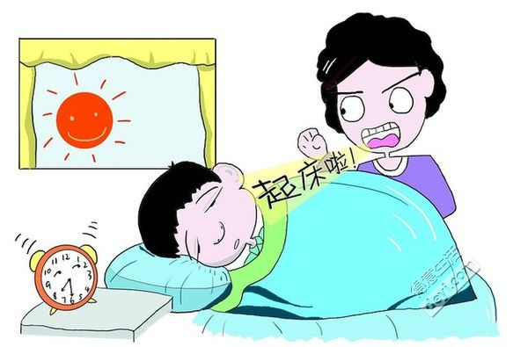
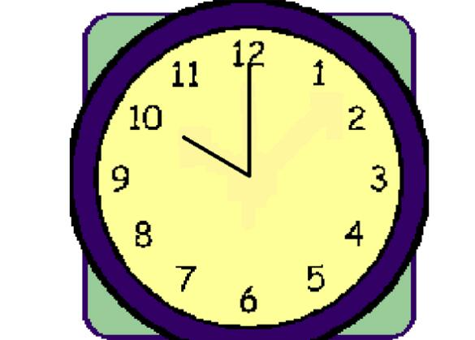
http://img.deyi.net/forum/201311/29/110004d22jo1y1mpzoyd4a.jpg
http://www.rwxzw.com/uploads/allimg/160121/1-16012114361EY.jpg

Slide 3
http://img01.taopic.com/150905/235049-150Z51IF914.jpg

Slide 4
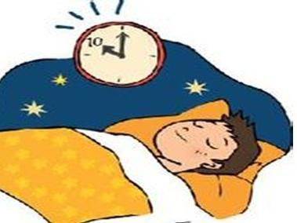
http://photocdn.sohu.com/20150914/mp31720806_1442192574707_1_th.jpeg

Slide 5
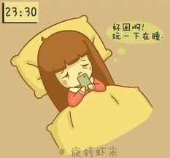
https://encrypted-tbn2.gstatic.com/images?q=tbn:ANd9GcRc04NdYV0xkiZMLEdq0GhrnZI_l5RmnTq7ThQFTZS-iwPZIDqn

Slide 6
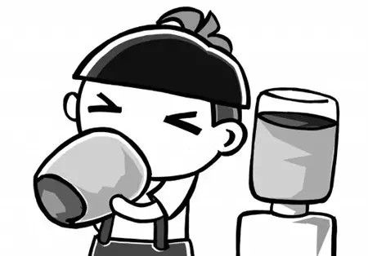
http://img.weixinyidu.com/150526/7a85a013.jpg_slt2

Slide 7
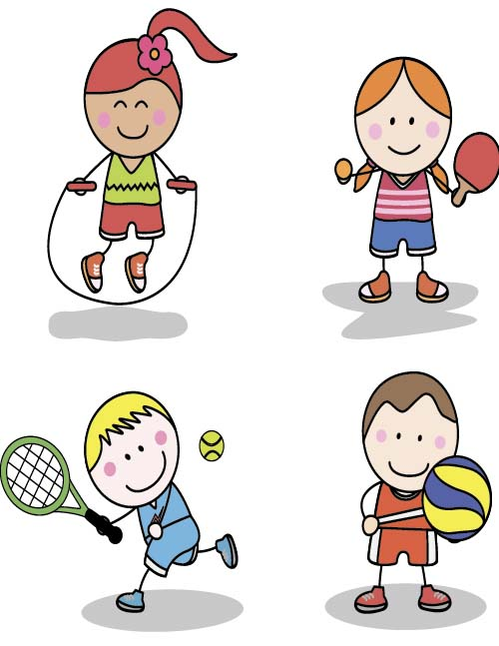
http://img01.taopic.com/150809/267872-150P911395890.jpg

Slide 8
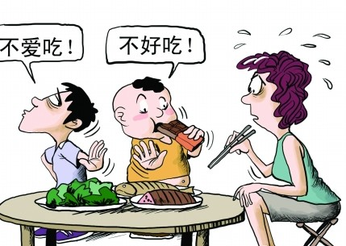
http://www.yinger.cn/yuer/uploadfile/2013/0419/20130419094254696.jpg

Slide 9
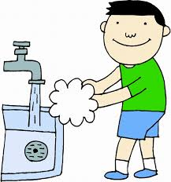
http://www.shaoerw.com/img/slimg/dw/images2278g471yt/321.jpg

Slide 10
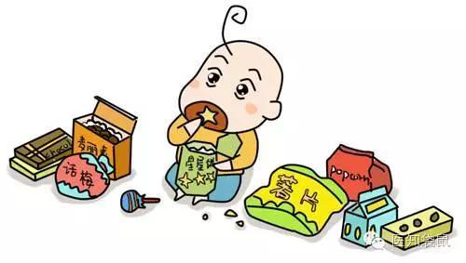
http://img.mp.itc.cn/upload/20160707/3db6a2962c34425fb646d95a6954e95b_th.jpg

Slide 11
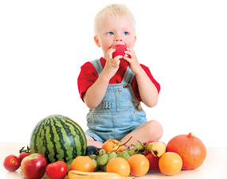
http://www.highlandhosp.com/wp-content/uploads/2015/06/immune.jpg

Slide 12
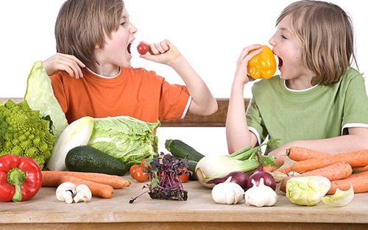
http://pic.pimg.tw/healthfoodage/1338474501-440836216.jpg

